Slide 1


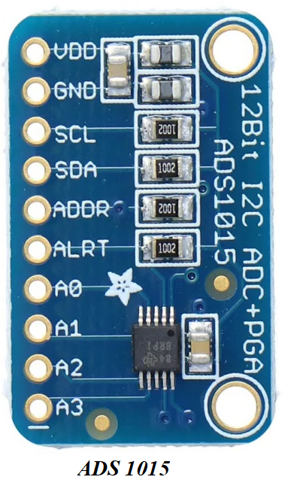
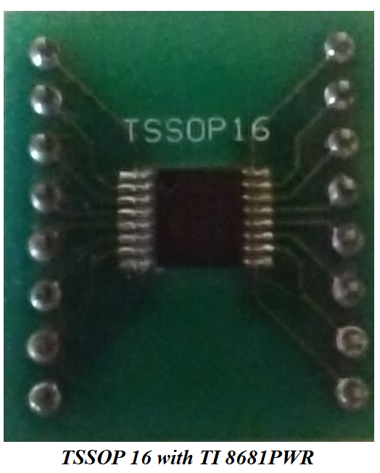
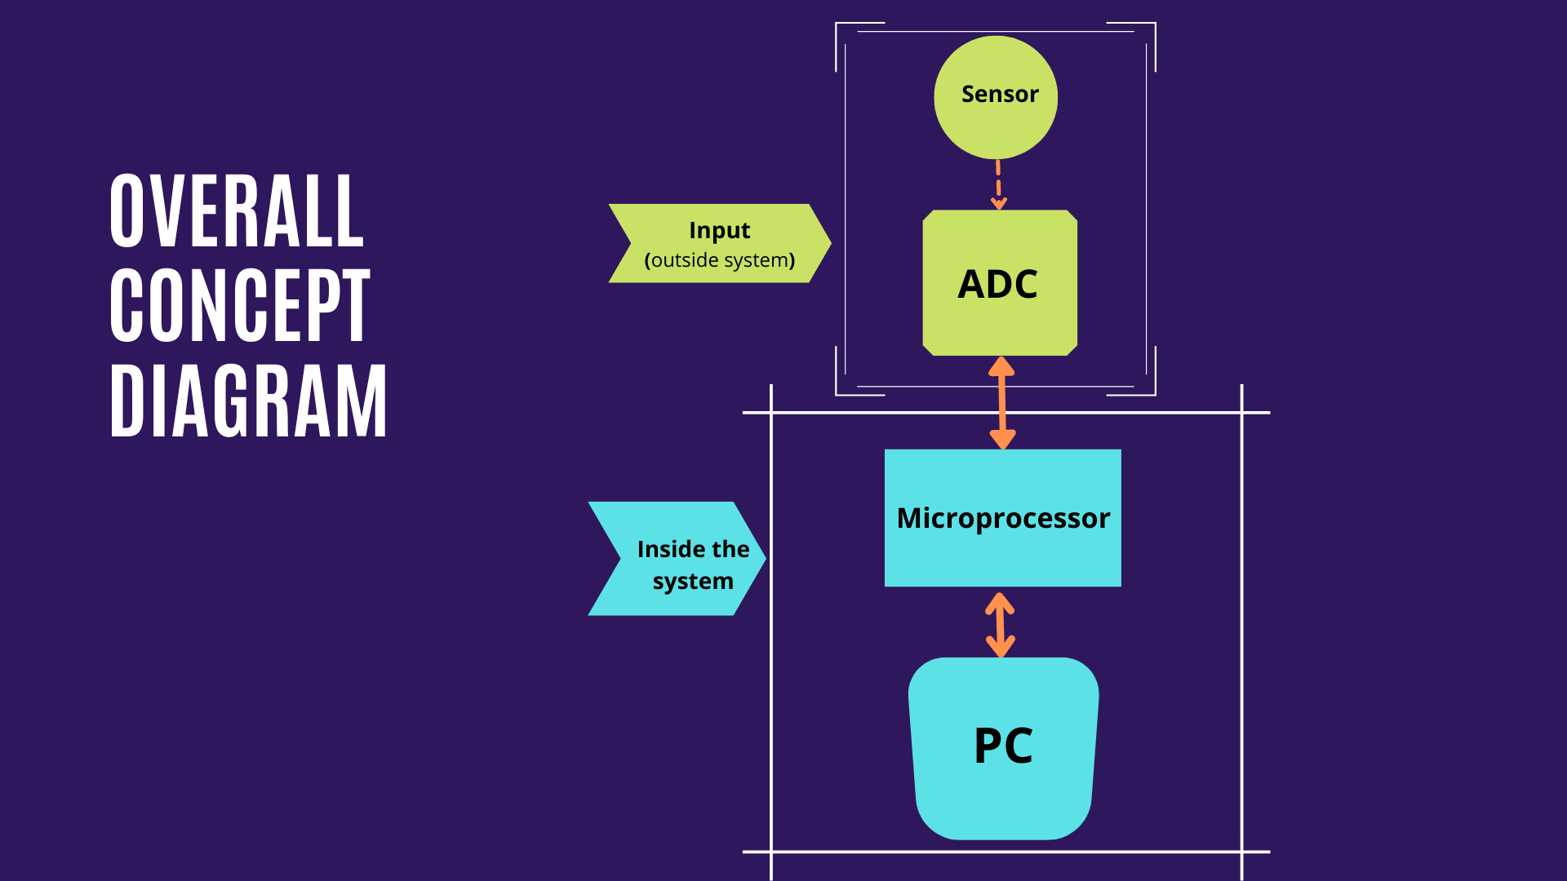
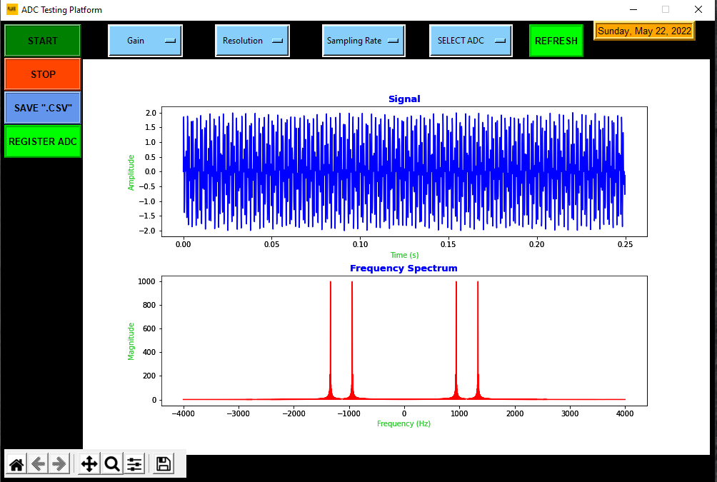
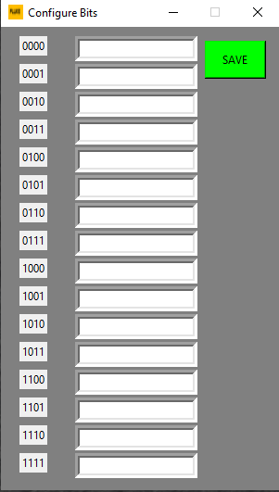
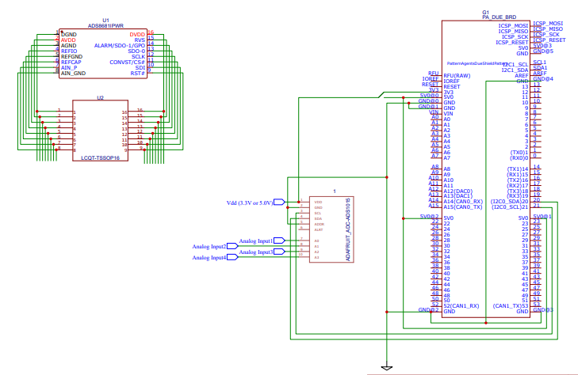
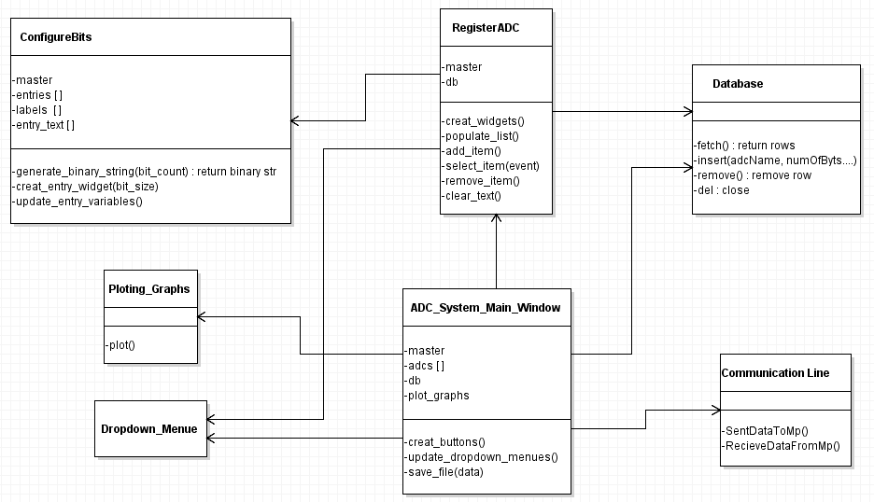
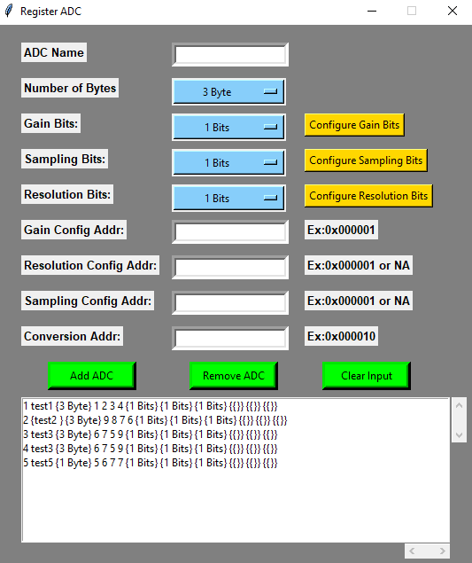
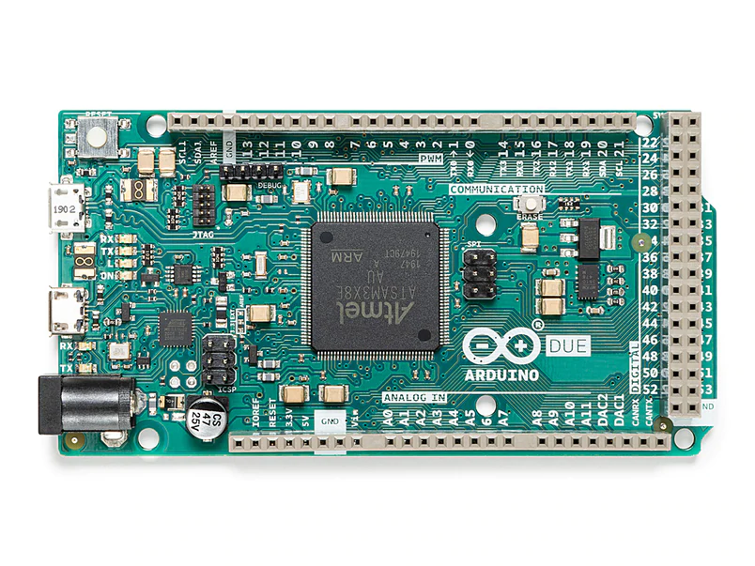
FLUKE ADC TESTING PLATFORM
STUDENTS: MICHAEL HOLLINGSHEAD, OBAID SIDIQI, SUKHWINDER SINGH
The ADC Testing Platform
Graphical User Interface
Hardware Components
The ADC Testing Platform is intended to be used as a development tool for assessing the performance of new analog to digital converter prototypes.
The ADC Testing Platform allows users to control the configuration settings of ADCs using I²C and limited SPI serial communication protocols.
Users can adjust the gain, sampling rate, and resolution on supported ADCs.
ADC conversion data is sent to the PC, where the data is plotted in the time and frequency domain. Users may export the raw data and plots for further analysis.
This user-friendly Graphical User Interface makes it easy to communicate directly with the Arduino and ADC to perform the desired analog to digital conversions.
Users are able to register different ADC configurations in this system and select those configurations from an ADC selection dropdown menu. This system will maintain registered ADCs in a local database for future use.
Upon clicking the Start button, the system will communicate with Arduino to start the ADC configuration and subsequent data acquisition
Upon clicking the Stop button, the system will stop data acquisition and then plot the obtained data in time and frequency domains.
Users can change the three parameters Gain, resolution, and sampling rate to assess the performance of different ADCs by analyzing the plots.
Adafruit ADS1015
TI 8681PWR with TSSOP16 breakout chipset
TI 8681PWR with PA0034 breakout chipset
[2]
Hardware Schematic
Two test ADCs are used to validate the ADC Testing Platform:
  TI ADS8681
  Adafruit ADS1015.
The TI ADS8681 is placed on a breakout chipset that allows the ADC to be connected to the Arduino.
Jumper cablesare used to connect to I/O pins on the Arduino. The pin locations vary on serial communication type;
The Adafruit ADS1015 uses I²C pins, SCL and SDA, to communicate with the Arduino
The TI ADS8681 uses the Arduino Due’s specific SPI pin block to communicate.
Arduino Due
INTERFACE OBJECT DIAGRAM
The Arduino Due acts as the bridge between the GUI and the ADC.
The Arduino connects to the PC via USB, and to the ADC from serial communication specific pins.
The Arduino receives configuration data from the PC, and relays that data to the ADC’s configuration registers.
The Arduino collects conversion data from the ADC and transmits it to the PC
ADC system main window will create the widgets in the main screen
The Main-window will call the Register ADC object to add or remove an ADC to the system
The local database object is used to maintain the information for registered ADCs in the system
Main-window asks the database for the registered ADC information
The Main-window calls upon plotting objects to plot the data
Communication-Line object is used to communicate data with the Microprocessor and ADC
Future Work, References, and Acknowledgments
Expand SPI compatible device
Upgrade evaluation board’s processor for a higher data throughput
Implement further analysis tools inside the GUI
Faculty: Professor Tia Chen
Graduate Student: Sukhwinder Singh
Undergraduate Students: Michael Hollingshead, Obaid A Sidiqi
[1] Wikipedia contributors. (2022, February 26). Tkinter. Wikipedia. https://en.wikipedia.org/wiki/Tkinter#cite_note-1
[2] SQLite - Python. (2020). Tutorial Point. https://www.tutorialspoint.com/sqlite/sqlite_python.htm
ADVISORS: SAMANTHA GETTING, ALLIE TORCHIA, SHRUTI MISRA
SPONSORS: ELECTRICAL & COMPUTER ENGINEERING DEPARTMENT, UNIVERSITY OF WASHINGTON AND FLUKE CORPORATION - EVERETT

